Slide 1
Electrical Engineering (UEE001)

Slide 2
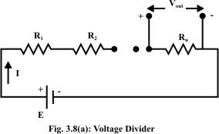

Voltage Divider

Slide 3
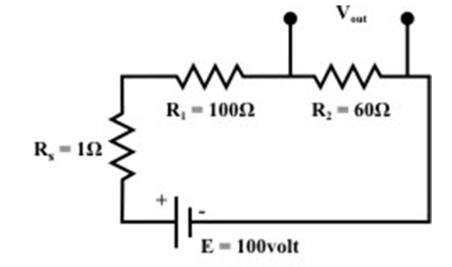
Example Problem
R_{s} not considered. V_{out} = V_{s} x R₂/(R₁+R₂) = 37.90 V
R_{s} considered. V_{out} = V_{s} x R₂/(R_{s}+R₁+R₂) = 37.27 V

Slide 4
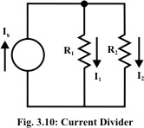
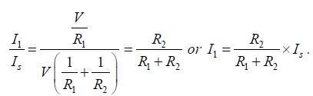

Current divider

Slide 5
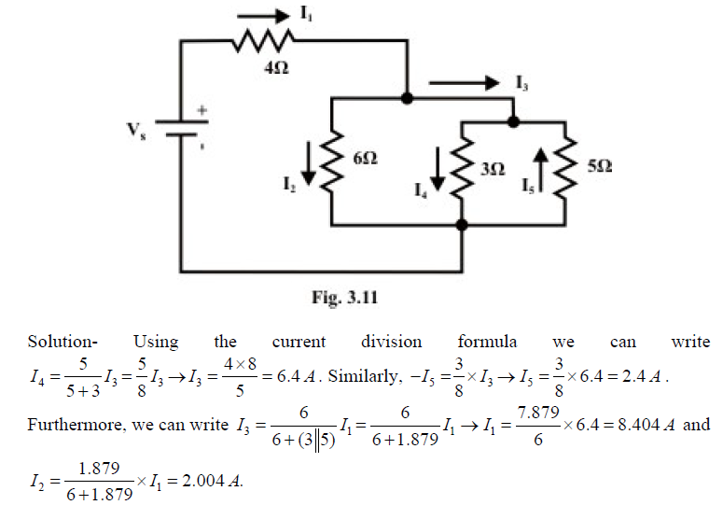
Find all the currents when I₄ = 4 A

Slide 6
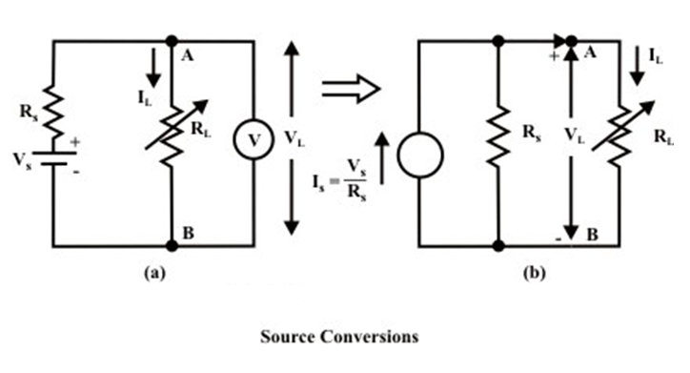

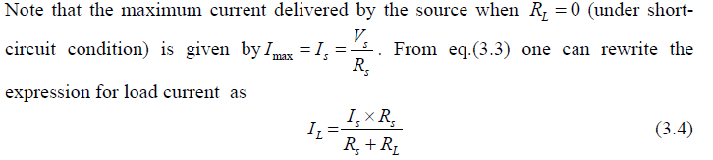
Voltage Source to Current Source

Slide 7
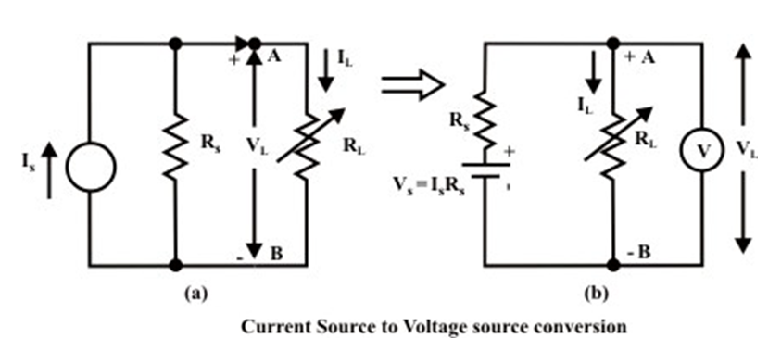

Current Source to Voltage Source

Slide 8
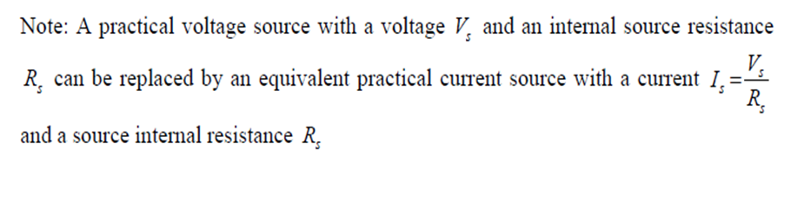
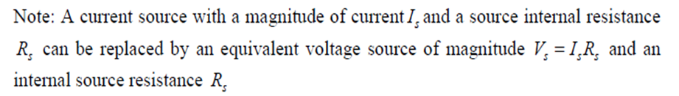
Source Conversion

Slide 9
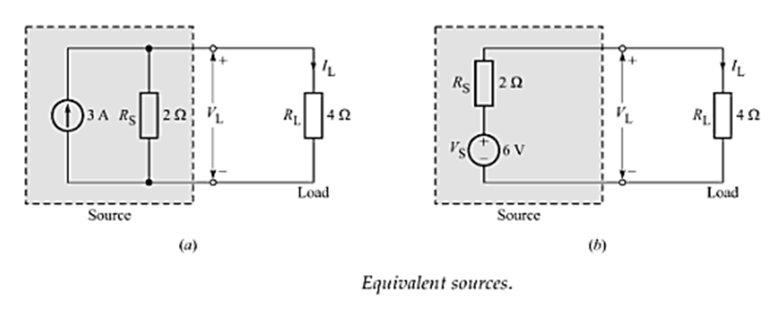
Example Conversion

Slide 10
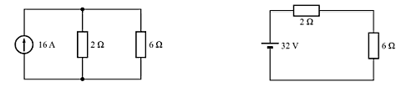


Example Problem

Slide 11
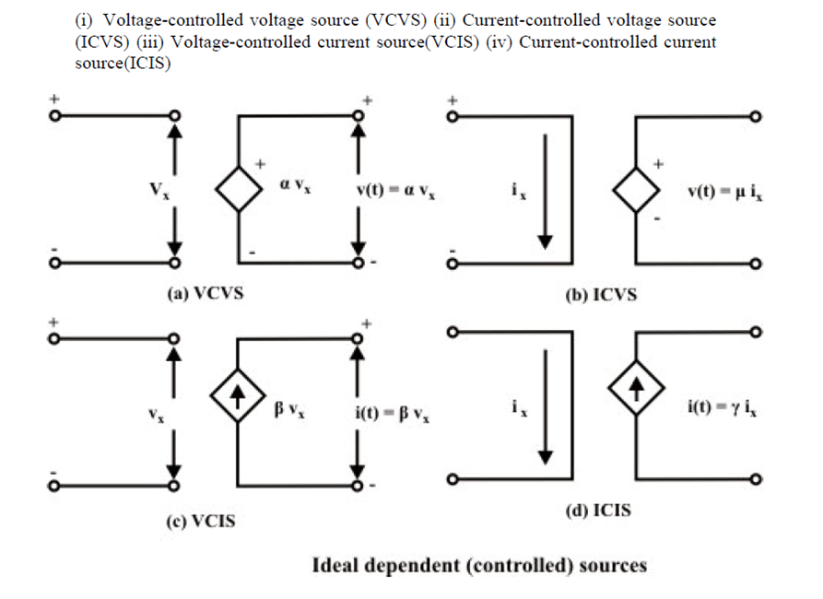
Independent and Dependent Sources

Slide 12
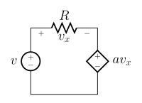
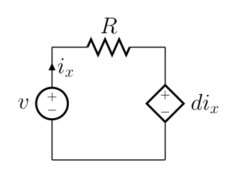
DEPENDENT SOURCES
Voltage dependent Voltage source
Current dependent Voltage source

Slide 13
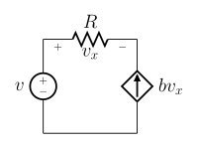
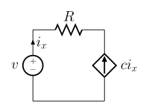
DEPENDENT SOURCES
Voltage dependent Current source
Current dependent Current source

Slide 14
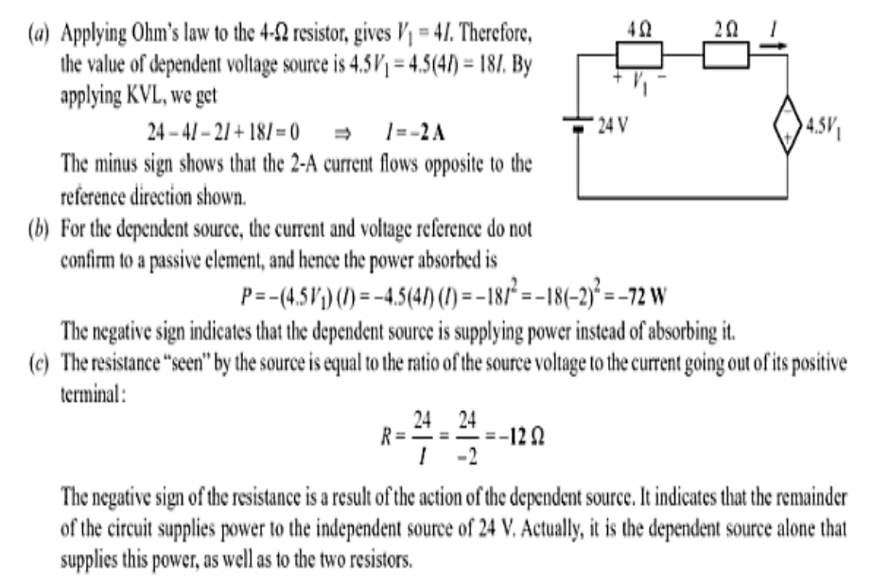

Slide 15
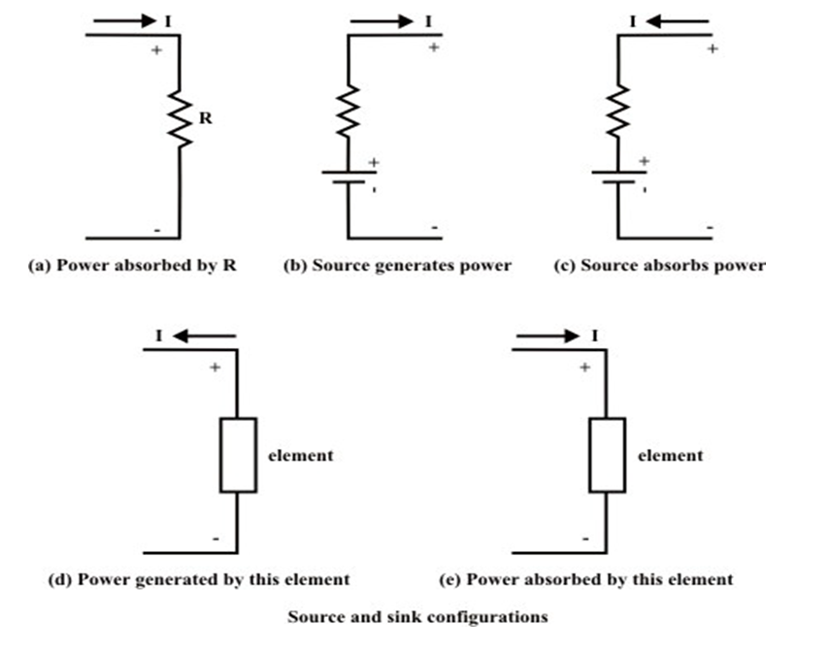
Power Convention

Slide 16
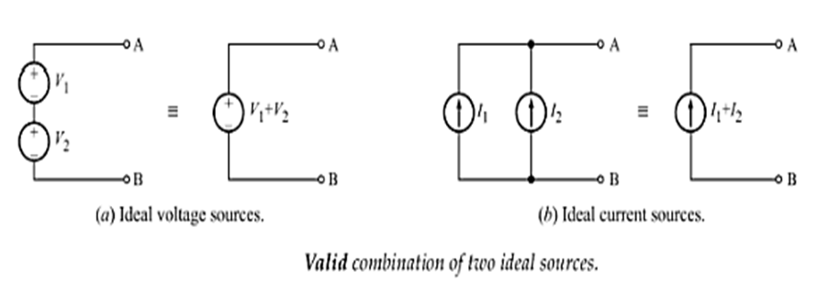
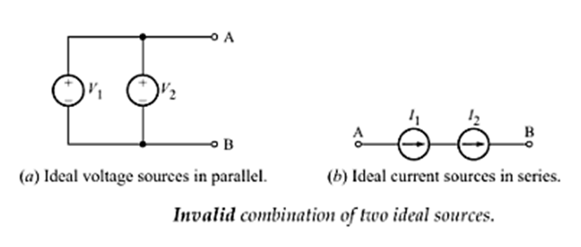
Combination of Sources

Slide 17
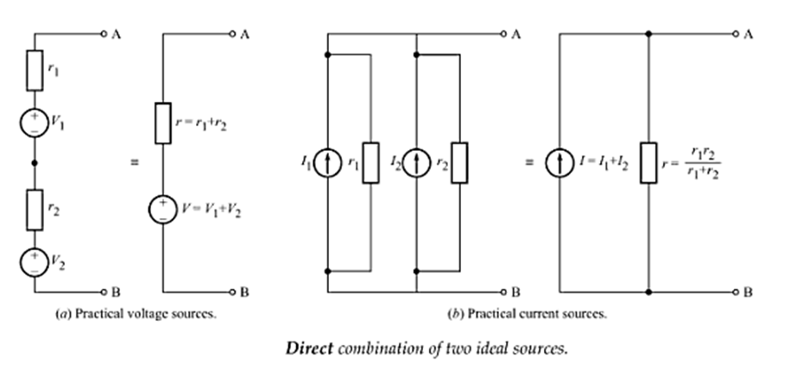
Combination of Sources

Slide 18
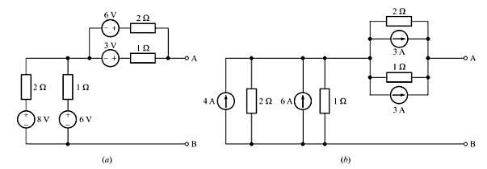
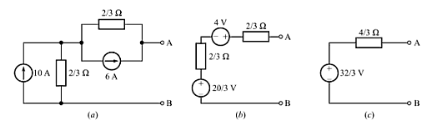
Example Problem

